Slide 1

More specific example:
optimal foraging under predation risk

Slide 2
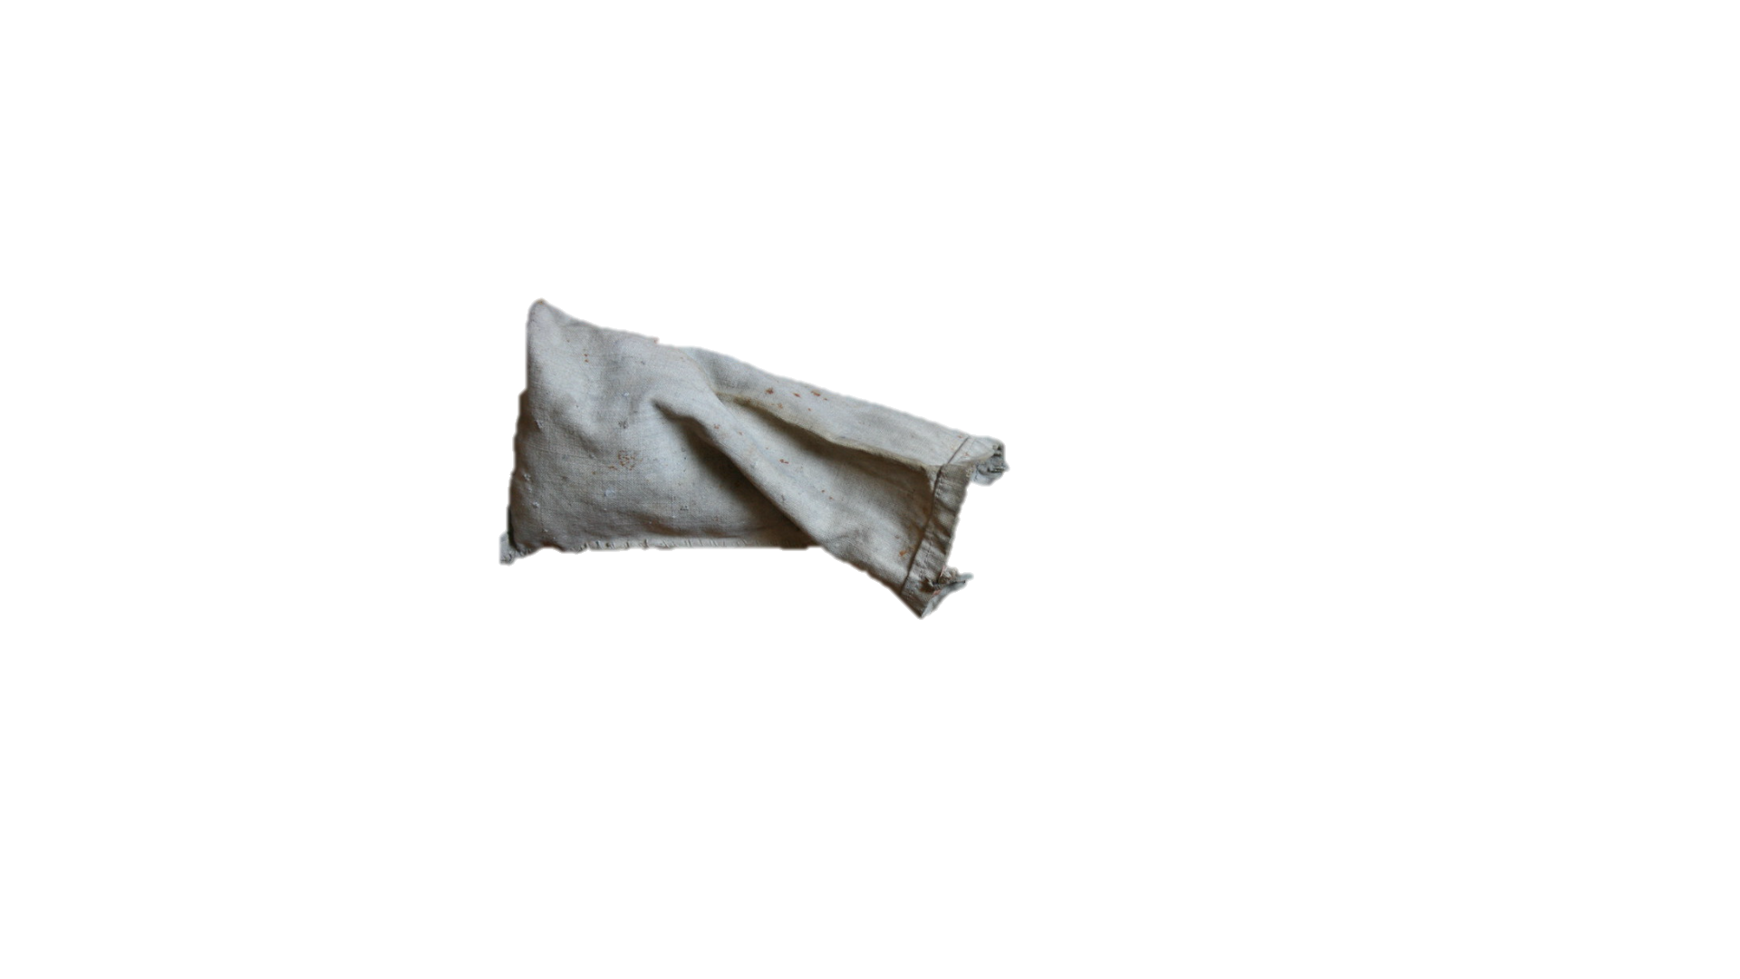



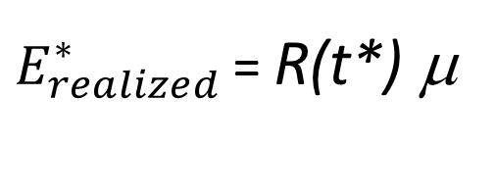
Example of how multiscale energy gain can be estimated over a short period of time
Prey
hide
$E_{realized}^{∗}$ = R(t*) μ
Forage with diminushing return in a patch
Move between resources patches
Use of refuge
Adjust T_{s}, T_{h}, T_{r} to obtain max(E_{realized}), given a total foraging time of 30 min, i.e., T_{s} + T_{h} + T_{r} = T_{f} = 30 min
Predator

Slide 3




Example of forager experiencing diminishing return
Yellow: 9/99
Green: 9/98
Allowed to draw a marble every 5 sec
Type | Marbles in bag | $ | Handling time (sec)
 | 10 | 20 | 20
 | 20 | 5 | 20
 | 70 | 0 | 0
N(t) = N_{green}(t) + N_{yellow} (t) + N_{black}
N(1) = 100 = 10 + 10 + 70
1/5 of drawing green or yellow…
at the begining

Slide 4
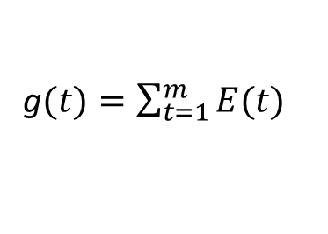
Example of forager experiencing diminishing return
λ(N₁(t-1) p₁)/N(t-1)
N₁(t) = N₁(t -1) – I₁(t-1)
N₁(t) = N₁(t-1) –
1 + λ[N₁(t-1) h₁p₁ + N₂(t-1) h₂p₂]/N(t-1)
λ(N₂(t-1) p₂)/N(t-1)
N₂(t) = N₂(t -1) – I₂(t-1)
N₂(t) = N₂(t-1) –
1 + λ[N₁(t-1) h₁p₁ + N₂(t-1) h₂p₂]/N(t-1)
x
N(t) = N₁(t) + N₂(t) + N_{Ø}
Assuming p₂ = 0
g ($)
x
N₁
λ[N₁(t-1) p₁e₁ + N₂(t-1) p₂e₂] / N(t-1)
E(t) =
Assuming p₂ = 0
1 + λ[N₁(t-1) h₁p₁ + N₂(t-1) h₂p₂] / N(t-1)
g$(t)=\sum_{t=1}^{m}{E(t)}$
Time (min)
Time (min)
λ : Encounter rate, i.e., number of marbles that can be drawn / min, excluding handling time
N_{i}(t) /N(t): Relative probability of encounter with a marble of type i item
p_{i}: Dichotomic variable indicating if type i marble is used (1) or not (0)
e_{i}: $ gained
h_{i}: Handing time (min)

Slide 5
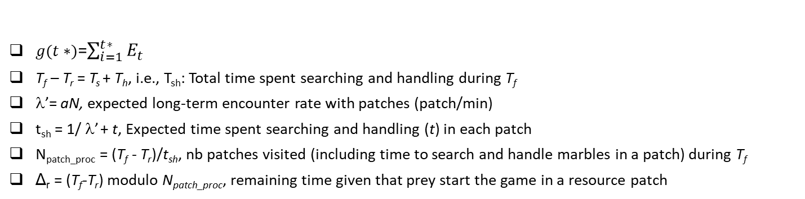
Inter-patch level over relatively short periods of time
T_{f}
T_{f}: Total foraging time (min), i.e., game duration
t
Searching
Waiting in refuge
Incomplete
$g(t∗)$=$\sum_{i=1}^{t∗}{E_{t}}$
T_{f} – T_{r} = T_{s} + T_{h}, i.e., T_{sh}: Total time spent searching and handling during T_{f}
λ’= aN, expected long-term encounter rate with patches (patch/min)
t_{sh} = 1/ λ’ + t, Expected time spent searching and handling (t) in each patch
N_{patch_proc} = (T_{f} - T_{r})/t_{sh}, nb patches visited (including time to search and handle marbles in a patch) during T_{f}
Δ_{r} = (T_{f}-T_{r}) modulo N_{patch_proc}, remaining time given that prey start the game in a resource patch
If (Δr - t < 0) → Prey did not have the time to completely handle the last patch
N_{patch_fully} = nb with resources fully handled, round down (N_{patch_proc})
t_{last} = Time spent foraging (i.e., searching and handling marbles) last patch = Δ_{r}
g_{m} = gain in the patches that was partially processe (i.e., early departure)
g_{total} = g(m-1) N_{patch_fully} + g_{m}
T_{h1} = t N_{patch_fully} + t_{last}
T_{s} = (1/ λ₁)N_{patch_fully}

Slide 6
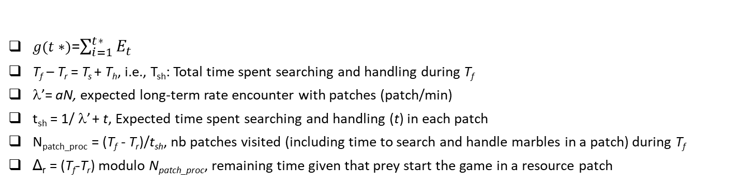
Inter-patch level over relatively short periods of time
T_{f}
t
Searching
Waiting in refuge
Incompletesearch
$g(t∗)$=$\sum_{i=1}^{t∗}{E_{t}}$
T_{f} – T_{r} = T_{s} + T_{h}, i.e., T_{sh}: Total time spent searching and handling during T_{f}
λ’= aN, expected long-term rate encounter with patches (patch/min)
t_{sh} = 1/ λ’ + t, Expected time spent searching and handling (t) in each patch
N_{patch_proc} = (T_{f} - T_{r})/t_{sh}, nb patches visited (including time to search and handle marbles in a patch) during T_{f}
Δ_{r} = (T_{f}-T_{r}) modulo N_{patch_proc}, remaining time given that prey start the game in a resource patch
If (Δr - h_{partch1} ≥ 0) → Prey had the time to completely handle the last patch visited
N_{patch_fully} = round up (N_{patch_proc}), nb with resource patches fully handled
t_{search} = Δr – h_{patch}
g_{total} = g(t) N_{patch_fully}
T_{h} = t N_{patch_fully}
T_{s} = (1/ λ₁) (N_{patch_fully} – 1) + t_{search}

Slide 7

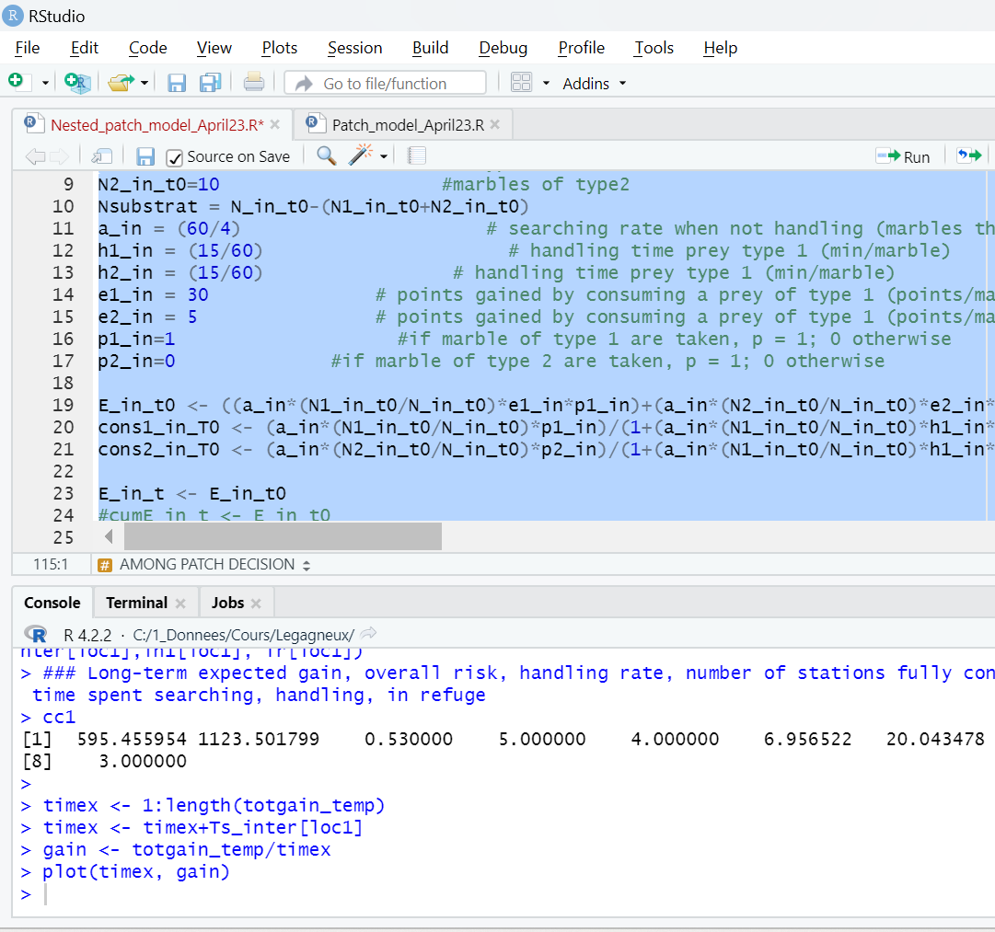
Optimal combination of T_{s}, T_{h} and T_{r}, given the optimal diet and residence time under predation risk, as identified numerically

